Slide 1

WYLLL Scorekeeper Clinic
Scott Gotreau
sagotreau@gmail.com

Slide 2
Introduction
Welcome to the scorekeeper’s training
Your record of the game helps us report accurate scores and resolve conflicts
Each team should provide 2 scorekeepers per game – one to keep score of the game and the other to keep track of the pitch count
The home team’s scorekeeper is designated as the official scorekeeper
As the “official scorekeeper,” you should remain impartial
Visiting Team should have one scorekeeper and confer with home scorekeeper to ensure pitch count/runs are accurate
Home scorekeeper has the final official record of the game and overrides the visitor’s record if there is a discrepancy

Slide 3
Some Do’s and Don’ts
Show up 30 minutes before scheduled game time or let the manager know if you will be running late
Remember you are a volunteer doing the league a service as best you can so have fun!
Always try to bring illegal substitutions (pitcher/catcher)to the attention of the plate umpire before the next pitch
Never identify “batting out of turn” to the umpire or anyone else. This is an appeal play and is the responsibility of the managers
Don’t show or express favoritism, even though your son/daughter and/or spouse is on one of the teams. Cheering good plays is acceptable
Never publicly disagree with the umpires or offer your own opinion
Sit close to home plate but also where you can see the entire field

Slide 4
Setting Up: Checklist
Bring pencils with you
Get the scorebook from your manager
Make yourself comfortable as games last about 2 hours
Get each team’s line up and starting pitcher
Transfer lineups to the book as early as possible
The plate umpire & the official scorekeeper are a team so be sure to introduce yourself and get the official start time of the game
Don’t be afraid to talk to the plate umpire and ask for clarification on a call or ask him to repeat a call on a pitch
The Plate Umpire has the final word on rule interpretation, including player eligibility, batting order, etc. Provide info, but do not publicly disagree

Slide 5
Rule Interpretations
If a manager disagrees with a rule interpretation he can put the game under protest, before the next pitch or play. The game will continue. If the manager wins the protest the game will pick up again from the time of the call in question. The same applies for a suspended game (rain delay/lights out)
Write down as much information as you can, such as: who was at bat, at-bat count, on base, inning and score when the game was protested
Draw a heavy line in the scorebook to indicate the point at which the protest occurred
Once the game has finished for that day, give the scoresheet and pitch count logs for both teams directly to the player agent or place them in your team’s cubby in the back side of the snack shack

Slide 6
Priorities
Accuracy of:
  1) Score
  2) Pitch Count
  3) Pitcher/Catcher
  4) Batting Order
  5) Balls/Strikes/Outs
  6) Official Time (AA & AAA only)
If you need a moment for clarification, ask the umpire between innings, or if absolutely necessary, ask the umpire for time between batters. Never interrupt during a play
The umpire makes final determination as to whether a run counts or not
Legibility - Try to be as neat and legible as possible

Slide 7
End of Game
At the conclusion of the game, it is the scorekeepers’ responsibility to do the following:
  Have the other team’s scorekeeper or manager sign your team’s pitch log
  Sign the pitch log for the opposing team verifying that you agree with the pitch counts
  Return pitch count log to your team’s manager
  Home team (if using scorebook): tear out scorebook page for that game and put it into your team’s cubby in the back of the snack shack
  Home team (if using Game Changer): email a copy of the scorebook and the box score to the player agent (more on this in the Game Changer tutorial)

Slide 8
Pitching & Catching Rules
The only positions the scorekeeper must record are pitcher and catcher; these positions should be updated every time they change
RULE:
A pitcher cannot pitch more than 40 pitches in a game and then catch. If a pitcher reaches the limit while facing a batter, the pitcher may continue to pitch until that batter reaches base or is put out or a third out is made. ONLY the first pitch to the last batter will be counted
A catcher cannot pitch in a game if he has caught more than 3 innings. If he catches a live pitch in the 4th inning, he is no longer eligible to pitch in that game
Any player who catches and then pitches cannot return to catching if the player throws more than 20 pitches

Slide 9
2023 Scorekeeper’s Q&A Session
There will be an optional virtual Q&A session for any scorekeepers who wish to attend
February 15 at 6:30 PM
Meeting Zoom Link:
https://us04web.zoom.us/j/9201284787?pwd=m3y1E8nrsgzVQBK0SKuRbV91oIVKIW.1

Slide 10
Scorebook or Game Changer
For the 2023 season, we are allowing official scorekeepers to use either a manual scorebook or the Game Changer app to record official scores
Click on the appropriate link below to select the tutorial you wish to view. You may return to this slide at any time to complete another tutorial.
Manual Book Tutorial
Game Changer Tutorial

Slide 11
Manual Scorekeeping
The basics of keeping score

Slide 12
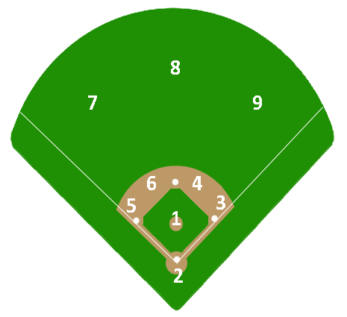
1 – Pitcher
2 – Catcher
3 – First Base
4 – Second Base
5 – Third Base
6 – Shortstop
7 – Left Field
8 – Center Field
9 – Right Field
Fielding Positions

Slide 13
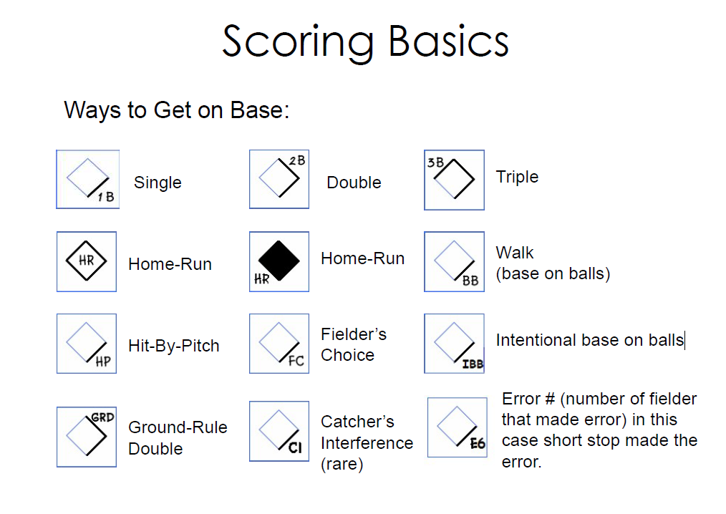

Slide 14
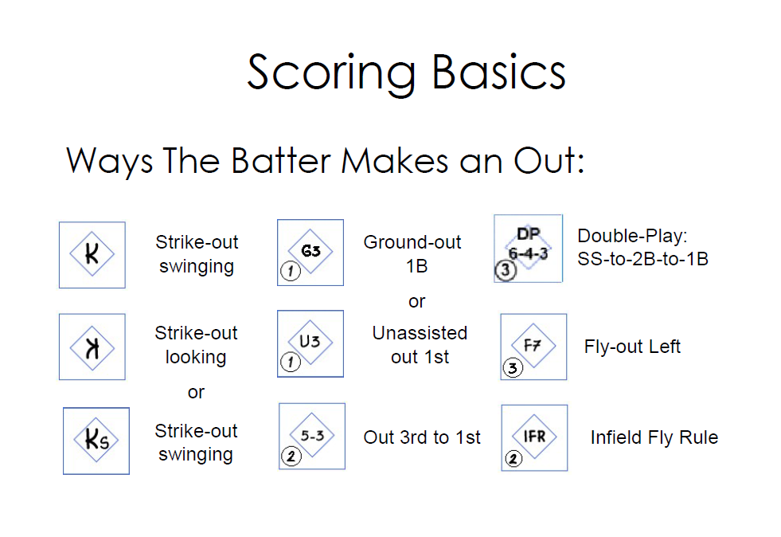

Slide 15
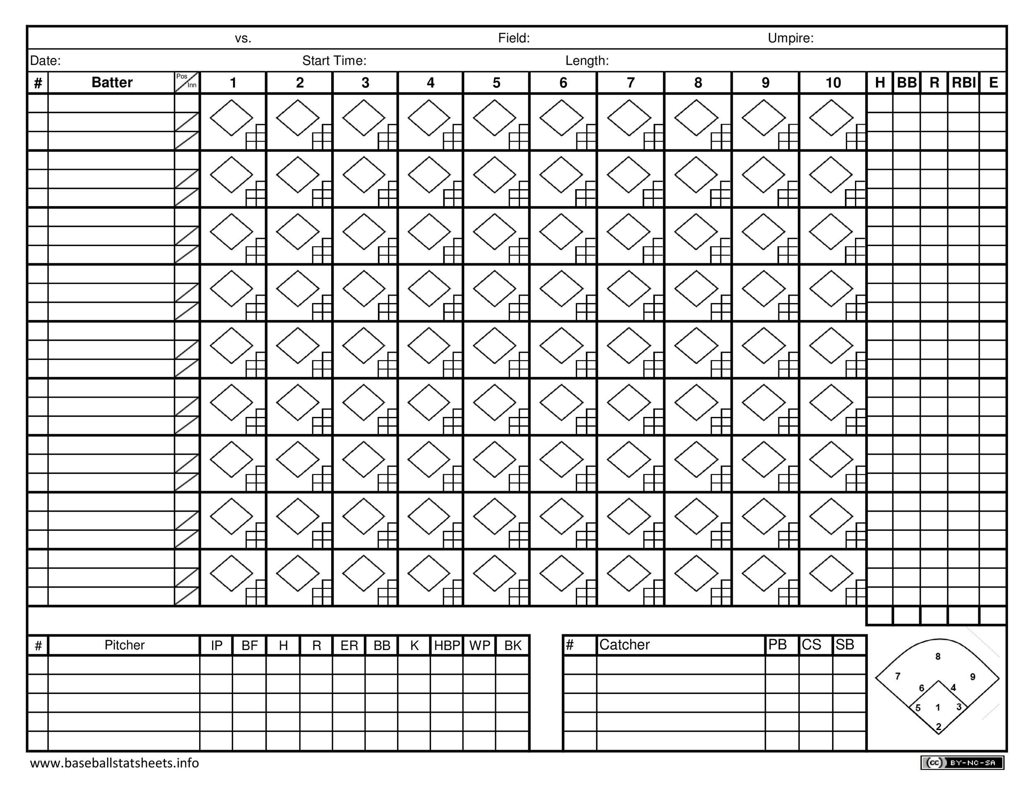

Slide 16
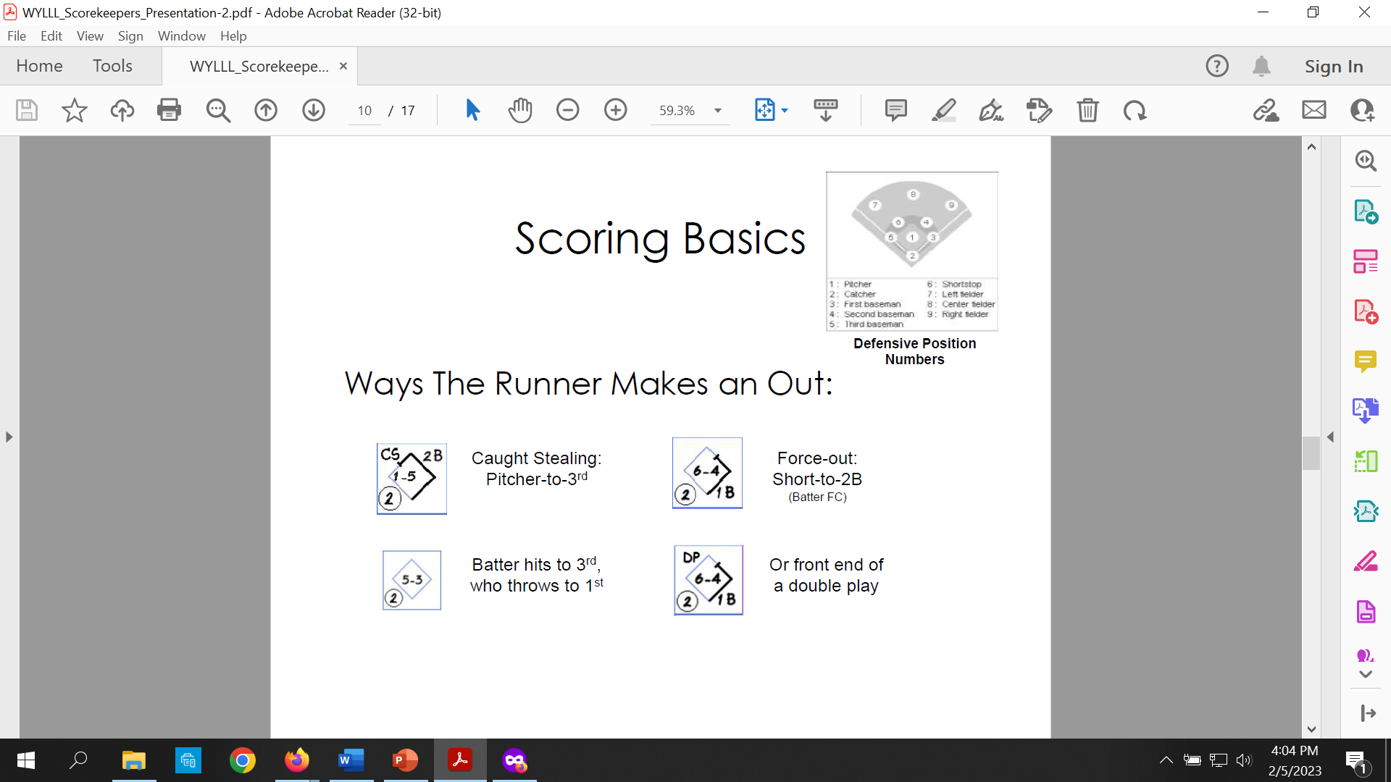

Slide 17
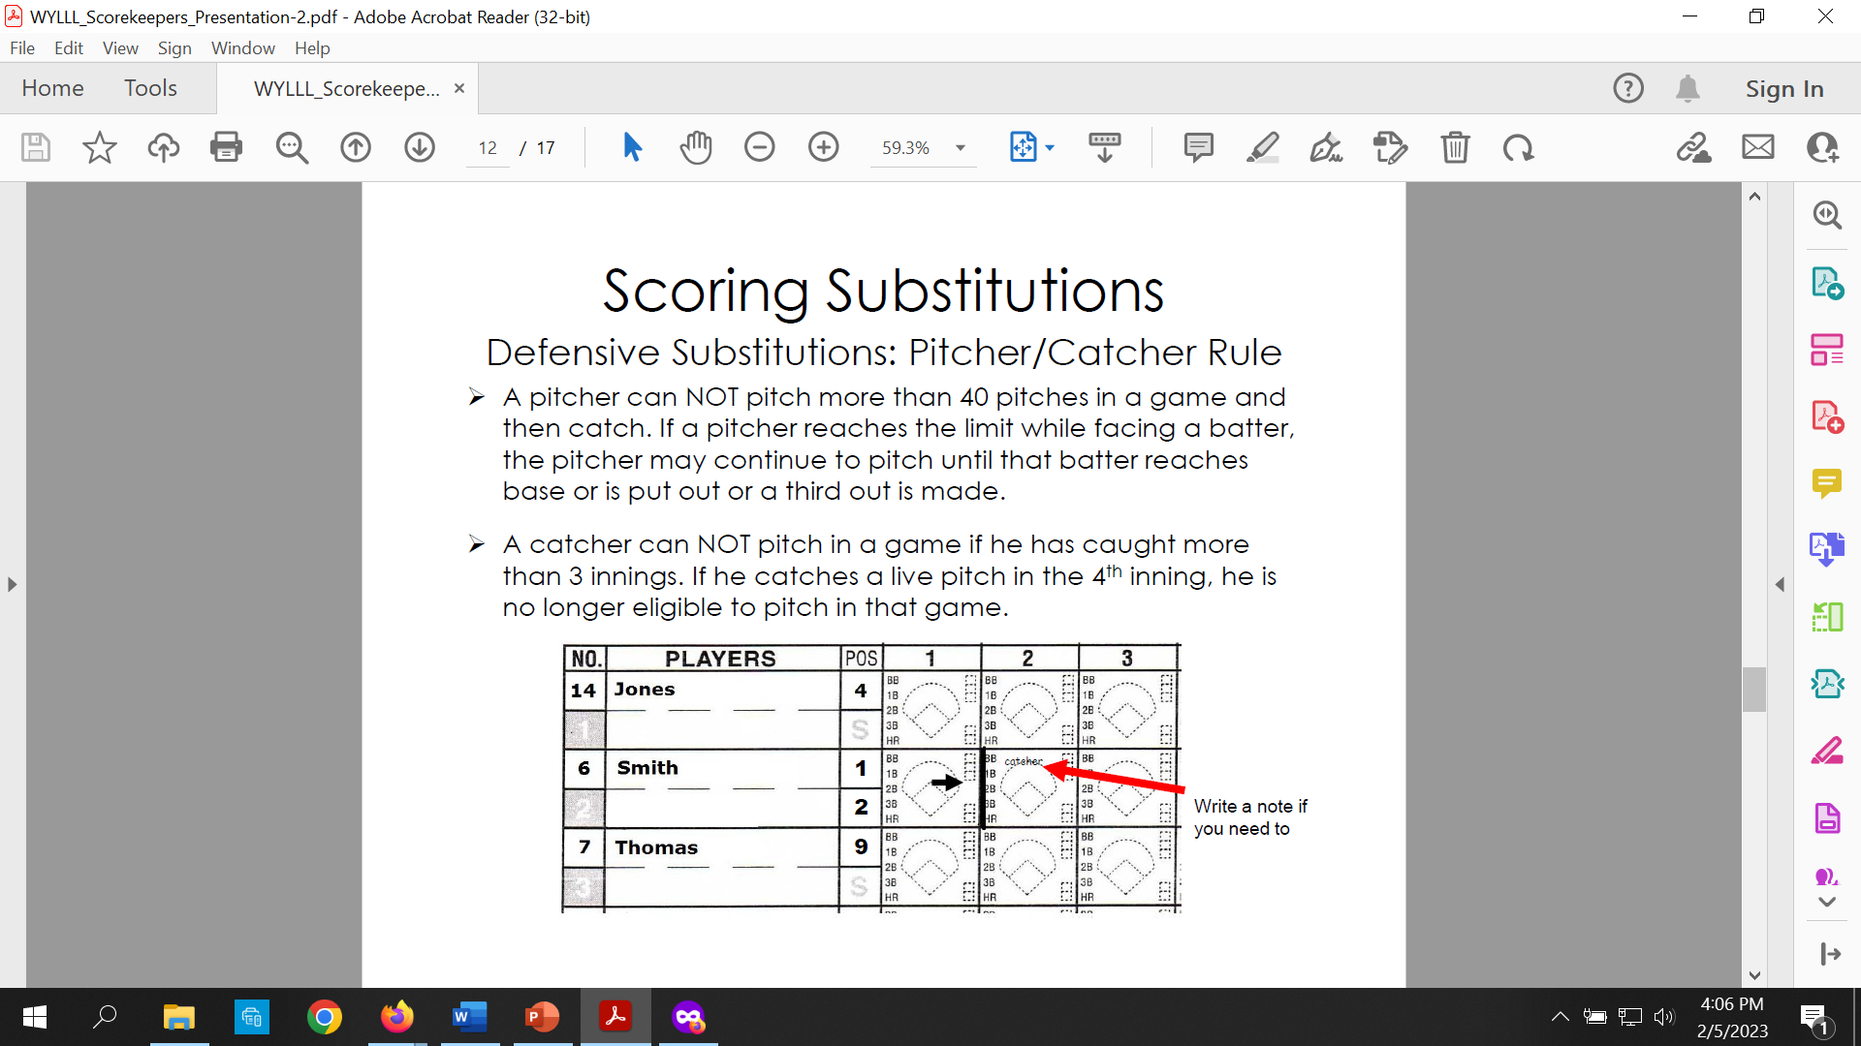

Slide 18
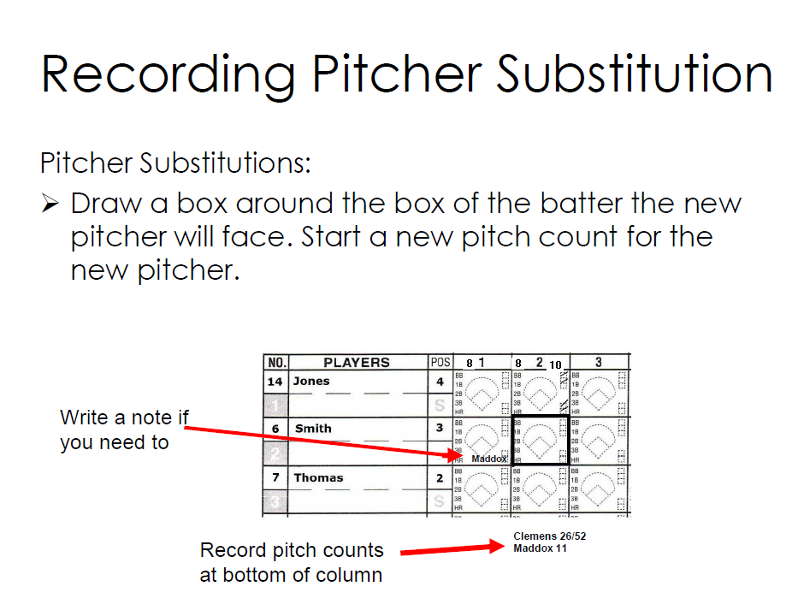

Slide 19
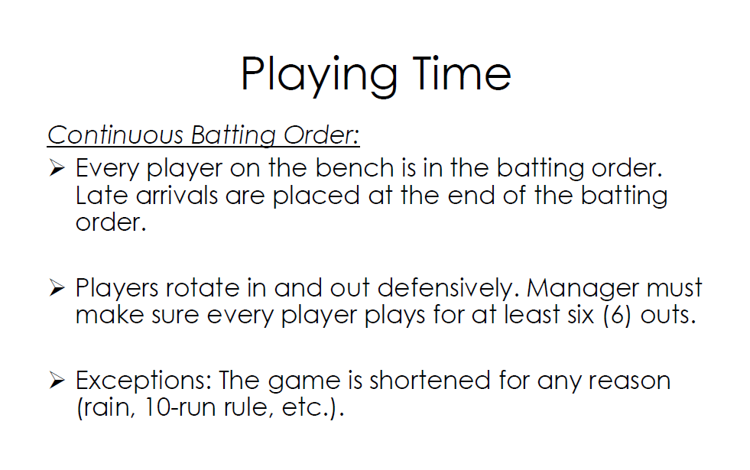

Slide 20
Pitch Count Rules
Age is based on the Little League age chart. While the player may be 10, Little League age says they are 11. Managers should know this. When in doubt, ask. Following are the maximum number of pitches for each player age
  7 or 8 year olds - 50 pitches per day
  9 or 10 year olds -75 pitches per day
  11 or 12 year olds - 85 pitches per day
  13 thru 16 year olds - 95 pitches per day
When a pitcher reaches comes within about 5 pitches of his/her maximum threshold, inform the plate umpire before the next batter
If a pitcher reaches the limit while facing a batter, the pitcher may continue to pitch until that batter reaches base or is put out or a third out is made
If the pitcher reaches the limit on his/her last pitch to a particular batter, the pitcher must be removed before delivering a pitch to the next batter

Slide 21
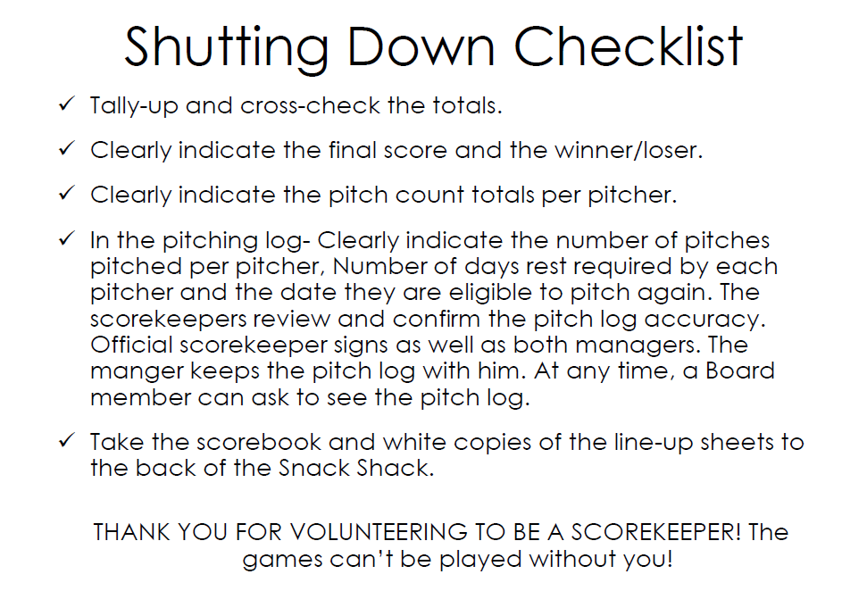

Slide 22
Thank You
Feel free to direct any questions to Scott Gotreau: sagotreau@gmail.com

Slide 23
Using Game Changer
If you plan to use Game Changer, please be sure you are very familiar with the app
Tutorials for how to use Game Changer can be found HERE
The following tutorials should be viewed for use in scoring games. They are all very brief, but informative:
    1-4 6-12 26 28
See the next slide for information about submitting postgame scores

Slide 24
Submitting Scores with Game Changer
The Game Changer scorebook and box score must BOTH be emailed to the player agent at the conclusion of the game. This is the responsibility of the HOME TEAM. Here is how to obtain those documents
Scorebook: On the final summary screen, click “plays.” Then click the blue “scorebook” button to download a pdf file of the scorebook. Save it to email to the player agent
Box Score: On the final summary screen, click “box score.” Then click the blue “export pdf” button to download a pdf file of the box score. Save it to email to the player agent

Slide 25
Pitch Count Rules
Age is based on the Little League age chart. While the player may be 10, Little League age says they are 11. Managers should know this. When in doubt, ask. Following are the maximum number of pitches for each player age
  7 or 8 year olds - 50 pitches per day
  9 or 10 year olds -75 pitches per day
  11 or 12 year olds - 85 pitches per day
  13 thru 16 year olds - 95 pitches per day
When a pitcher reaches comes within about 5 pitches of his/her maximum threshold, inform the plate umpire before the next batter
If a pitcher reaches the limit while facing a batter, the pitcher may continue to pitch until that batter reaches base or is put out or a third out is made
If the pitcher reaches the limit on his/her last pitch to a particular batter, the pitcher must be removed before delivering a pitch to the next batter

Slide 26
Thank You
Feel free to direct any questions to Scott Gotreau: sagotreau@gmail.com

